Slide 1





Statistics Flight Education Series
Topic: One-Sample Proportion
Testing using Wald and
Profile Likelihood Methods
Presenter: Asher Hanson
AFCS PCIP 2021
Mentor: Andrew Zastovnik
Primary Statistician
(Global Power Fighters)
Date: 29 July 2021

Slide 2
Special Recognition
Much of the research for this project was done by members of the 412 Test Support Squadron.
Special Recognition to:
Andrew Zastovnik
Dr. J Brownlow

Slide 3
Presentation Overview
Review One-Sample Proportion Testing
Wald Intervals
Profile-Likelihood Intervals
Type I Error Simulation
Type II Error Simulation
Future Work
Internship Report

Slide 4
One-Sample Proportion Testing
Question from Pharma
Suppose that the current treatment for a disease cures 62% of all cases. A new treatment has been proposed and studied. In a sample of 80 subjects with the disease that were treated with a new method, 63 were cured.
Do the results of this study support the claim that the new method has a higher response rate than the existing method?

Slide 5
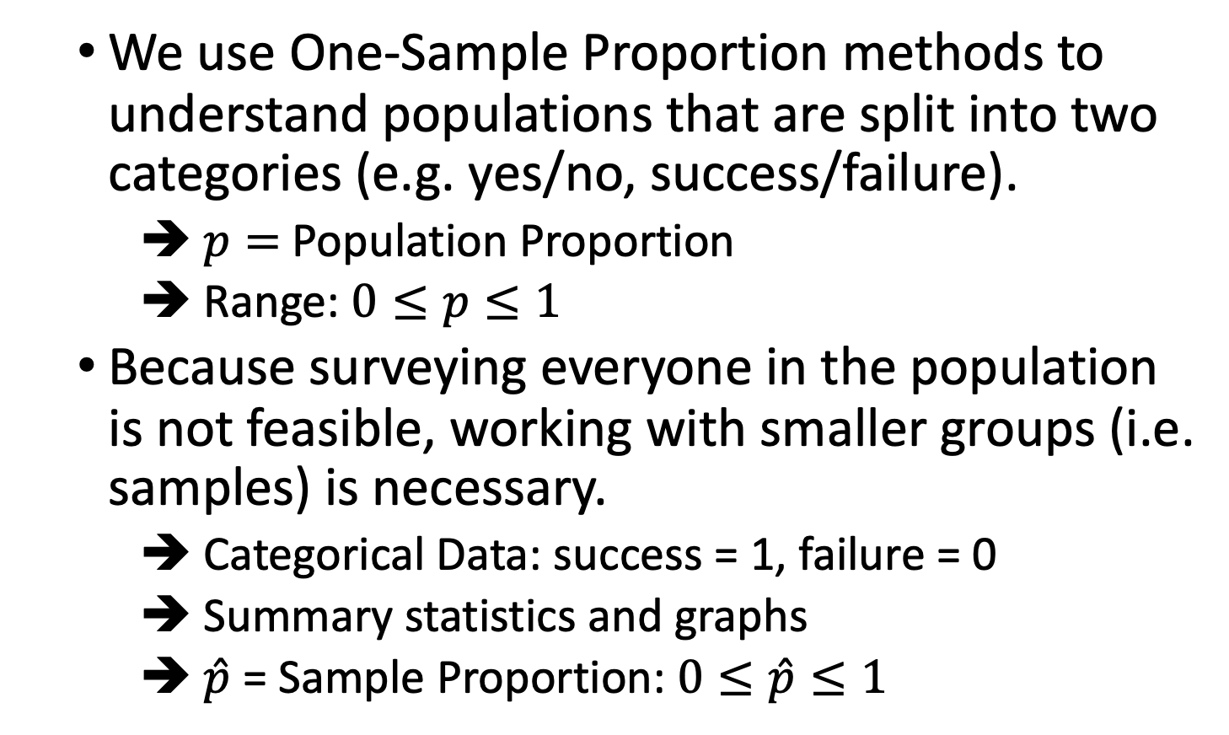
One-Sample Proportion Testing
We use One-Sample Proportion methods to understand populations that are split into two categories (e.g. yes/no, success/failure).
$p=$Population Proportion
Range: $0≤p≤1$
Because surveying everyone in the population is not feasible, working with smaller groups (i.e. samples) is necessary.
Categorical Data: success = 1, failure = 0
Summary statistics and graphs
$\hat{p}$ = Sample Proportion: $0≤\hat{p}≤1$

Slide 6
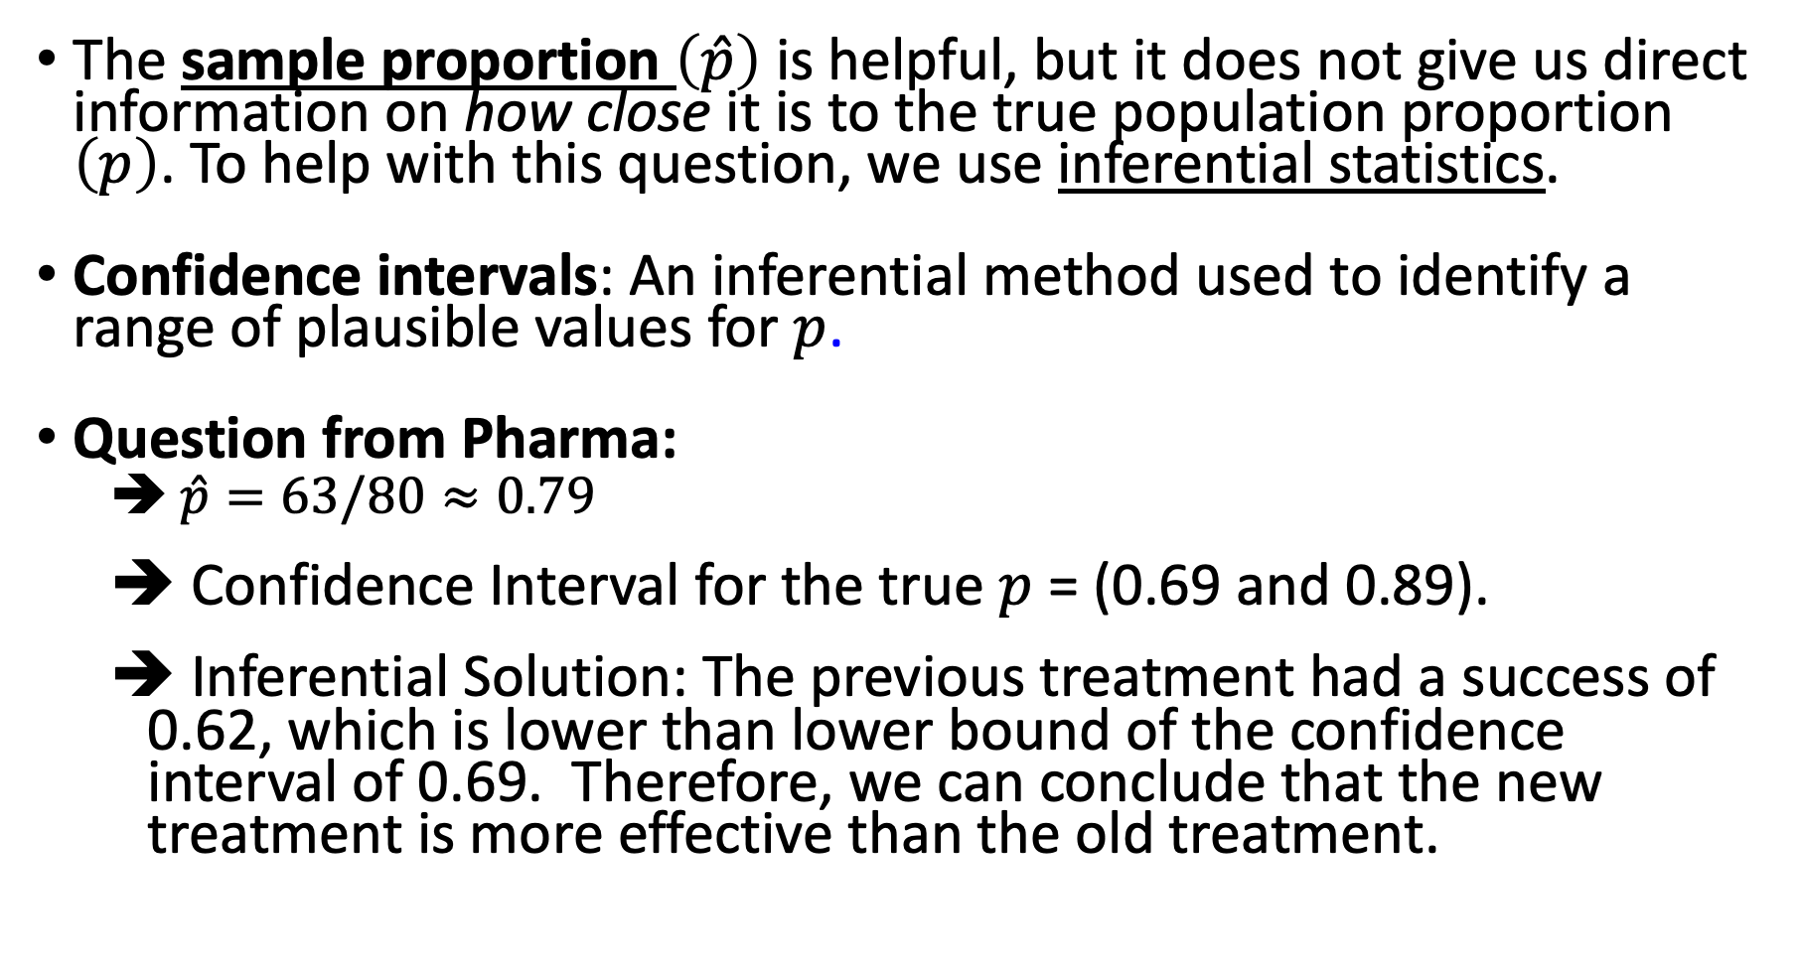
One-Sample Proportion Testing
The sample proportion $\left(\hat{p}\right)$ is helpful, but it does not give us direct information on how close it is to the true population proportion $\left(p\right)$. To help with this question, we use inferential statistics.
Confidence intervals: An inferential method used to identify a range of plausible values for $p$.
Question from Pharma:
➔ $\hat{p}=63/80≈0.79$
Confidence Interval for the true $p$ = (0.69 and 0.89).
Inferential Solution: The previous treatment had a success of 0.62, which is lower than lower bound of the confidence interval of 0.69. Therefore, we can conclude that the new treatment is more effective than the old treatment.

Slide 7
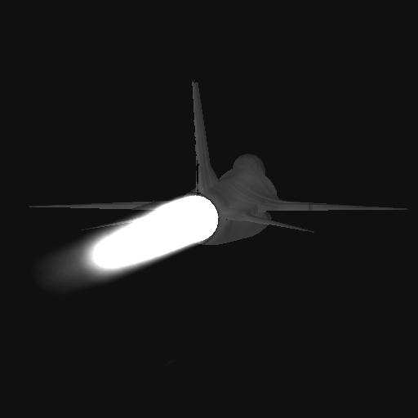

Air Force Example: Threat Identification Test
Jet engine signature can be used to identify friendly and enemy aircraft
A notional EW system is required to identify threats within 30 seconds
Threat identification system should have a 90% success rate to meet the required system specification.

Slide 8
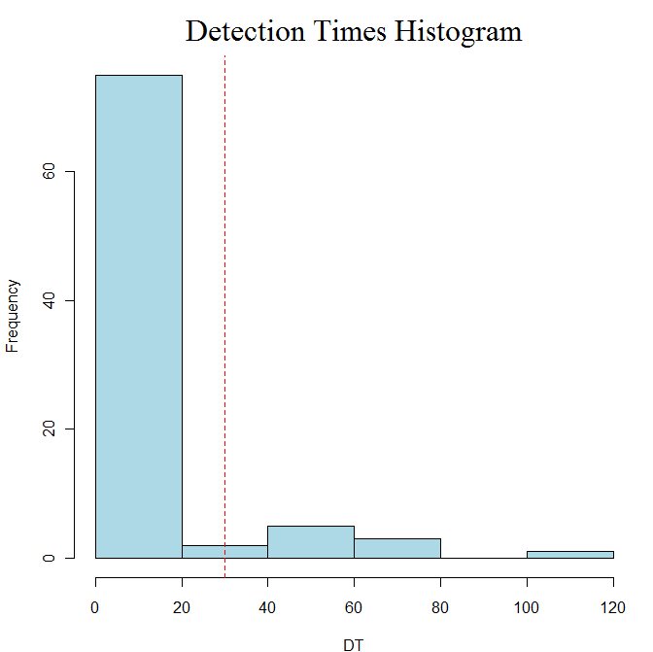
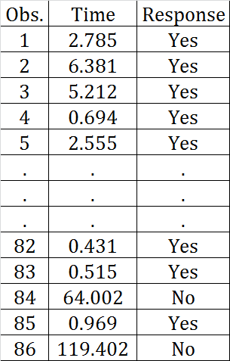
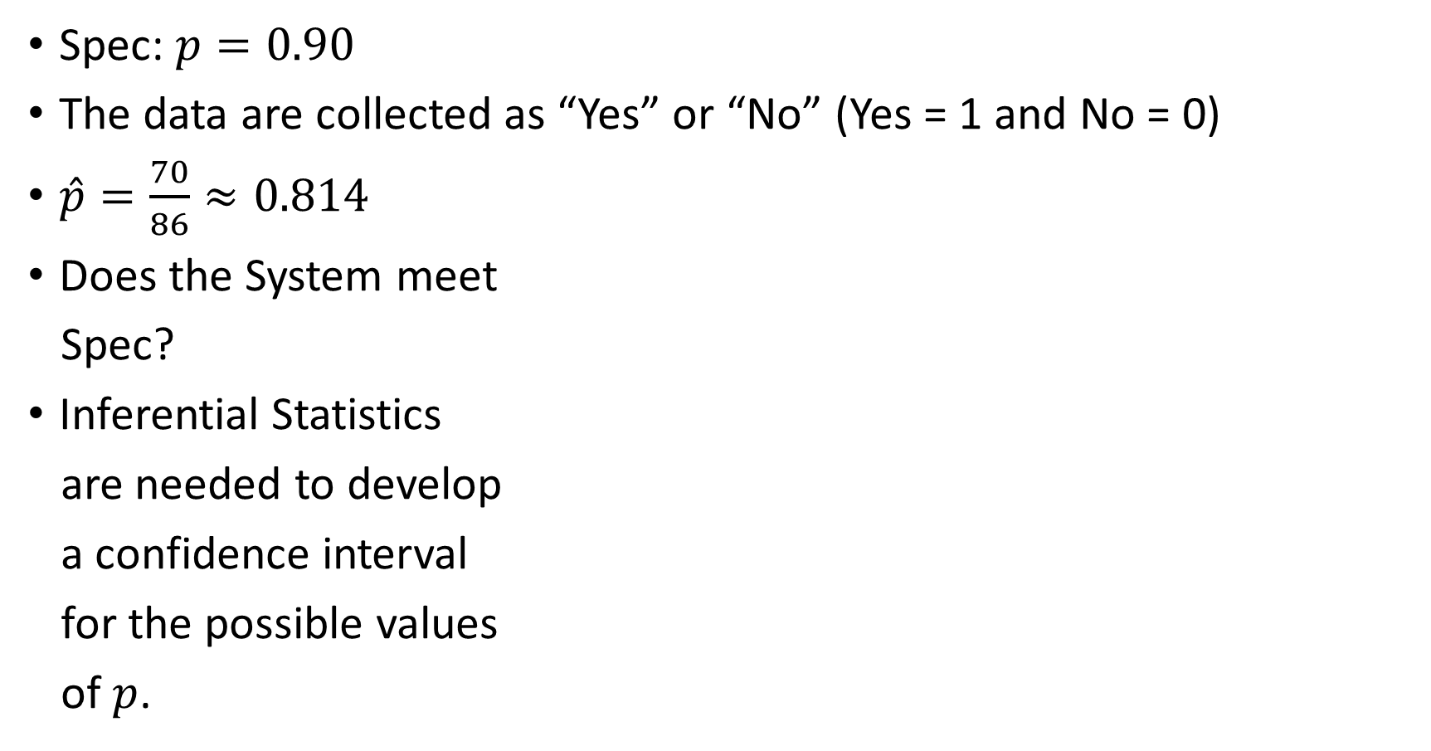
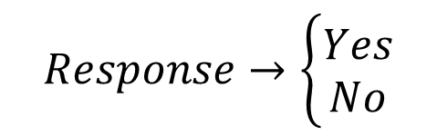
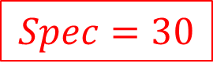
Example 1: Threat Identification Test
Spec: $p=0.90$
The data are collected as “Yes” or “No” (Yes = 1 and No = 0)
$\hat{p}=\frac{70}{86}≈0.814$
Does the System meet
Spec?
Inferential Statistics
are needed to develop
a confidence interval
for the possible values
of $p$.
$$Spec=30$$
$$Response→\left\{\begin{matrix}Yes \\ No\end{matrix}\right.$$

Slide 9
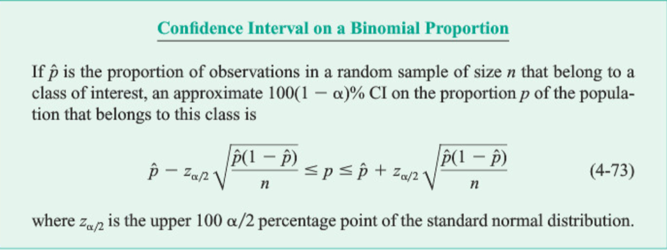
Confidence Intervals Overview
Reference: Montgomery et al, Engineering Statistics, 5th edition

Slide 10
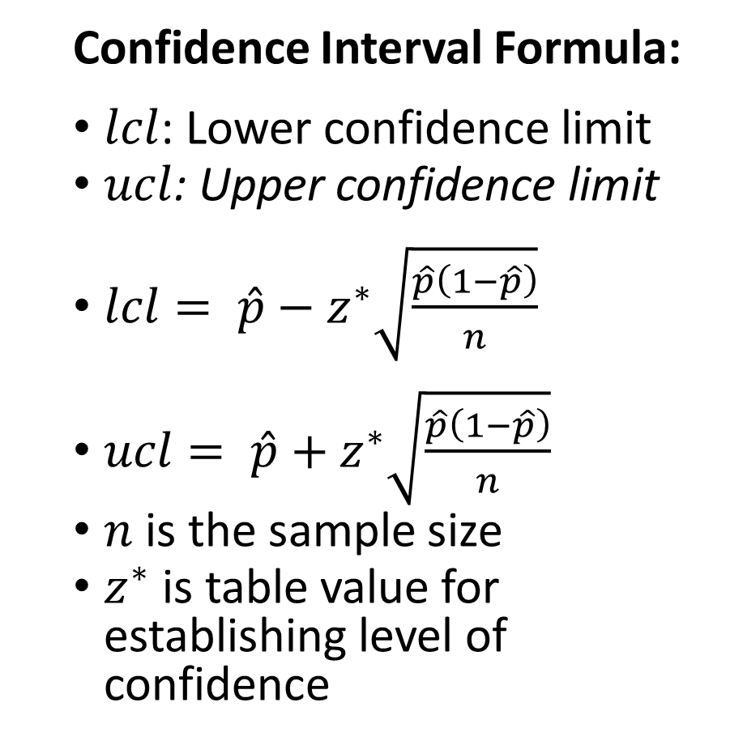
Confidence Interval
Confidence Interval Formula:
$lcl$: Lower confidence limit
$ucl$: Upper confidence limit
$lcl= \hat{p}−z^{∗}\sqrt{\frac{\hat{p}\left(1−\hat{p}\right)}{n}}$
$ucl= \hat{p}+z^{∗}\sqrt{\frac{\hat{p}\left(1−\hat{p}\right)}{n}}$
$n$ is the sample size
$z^{∗}$ is table value for establishing level of confidence
Desired Confidence | Z*
90% | 1.645
95% | 1.96
99% | 2.576
Point Estimate | n | Z* | Lower Confidence Limit | Upper Confidence Limit
.914 | 86 | (95%) 1.96 | .73 | .90
From the gathered results, it can be said that we are 95% confident that the true proportion of identifying a threat within 30 seconds is between 0.73 and 0.90.

Slide 11
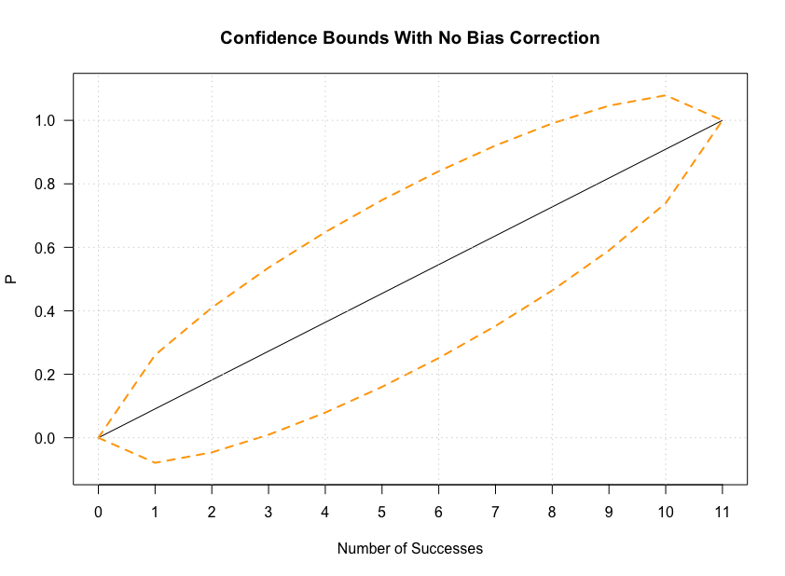
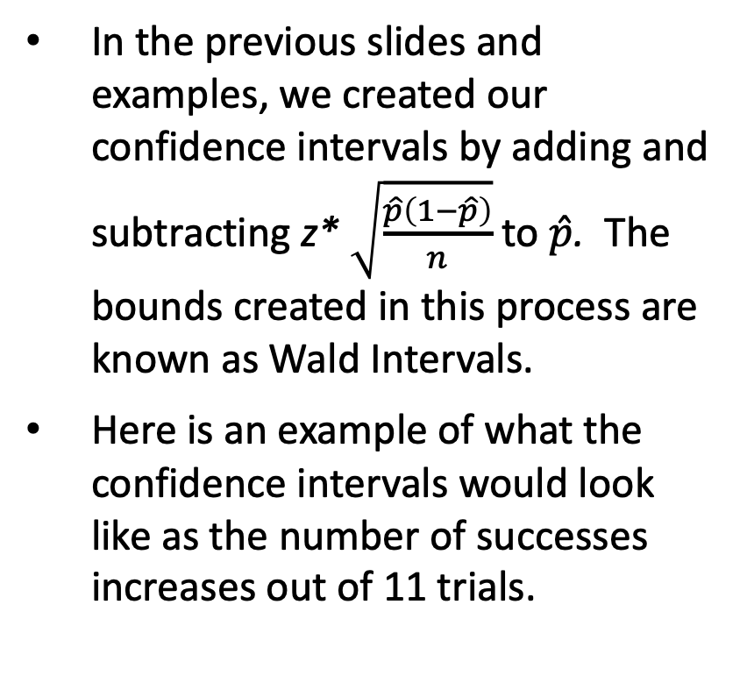
Wald Confidence Intervals
In the previous slides and examples, we created our confidence intervals by adding and subtracting z* $\sqrt{\frac{\hat{p}\left(1−\hat{p}\right)}{n}}$ to $\hat{p}$. The bounds created in this process are known as Wald Intervals.
Here is an example of what the confidence intervals would look like as the number of successes increases out of 11 trials.

Slide 12
Wald Confidence Intervals
Pros:
The Wald interval is the most basic confidence interval for proportions.
There are no modifications or corrections that are applied.
It is the most direct confidence interval that can be constructed from this normal approximation.
Cons:
The intervals created at times go above or below 0 and 1 probability, giving little insight into understandable insight to what is really happening.
The reliability of confidence intervals does not stay constant at every proportion; meaning that a 95% confidence isn’t true at every proportion.
An Edwards AFB Practitioner's Guide 11

Slide 13
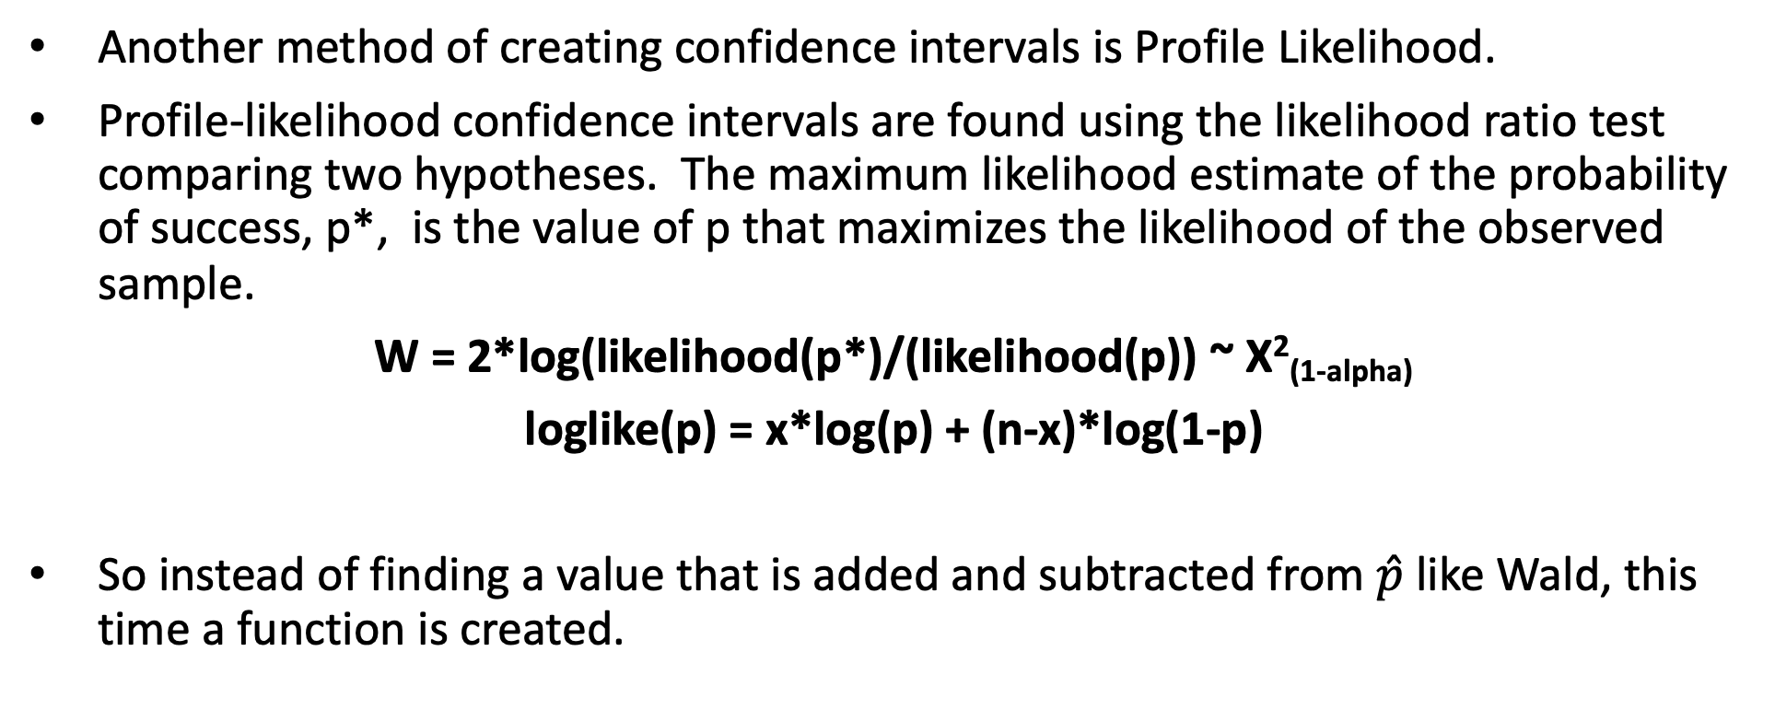
Profile Likelihood Confidence Intervals
Another method of creating confidence intervals is Profile Likelihood.
Profile-likelihood confidence intervals are found using the likelihood ratio test comparing two hypotheses. The maximum likelihood estimate of the probability of success, p*, is the value of p that maximizes the likelihood of the observed sample.
W = 2*log(likelihood(p*)/(likelihood(p)) ~ X²_{(1-alpha)}
loglike(p) = x*log(p) + (n-x)*log(1-p)
So instead of finding a value that is added and subtracted from $\hat{p}$ like Wald, this time a function is created.
An Edwards AFB Practitioner's Guide 12

Slide 14
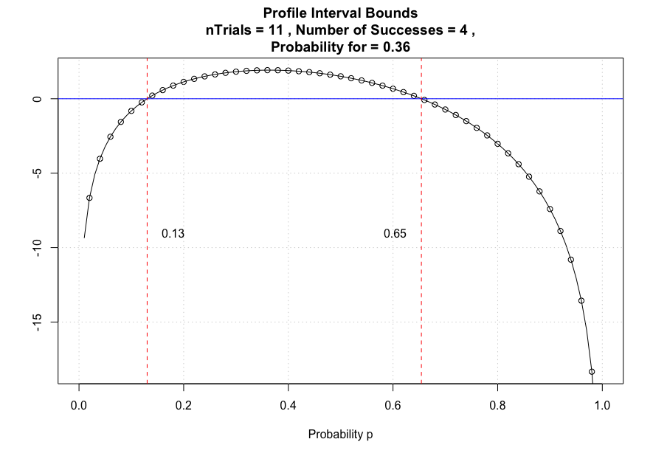
Profile Likelihood Confidence Intervals
This plot illustrates what is happening when each (p*) proportion is put into the log-likelihood function.
This plot will change as each (p*)proportion is used, creating a different intersections for where the function will cross 0.
In this plot, with 4 success, the lower bound is 0.13 and the upper is 0.65.
An Edwards AFB Practitioner's Guide 13

Slide 15
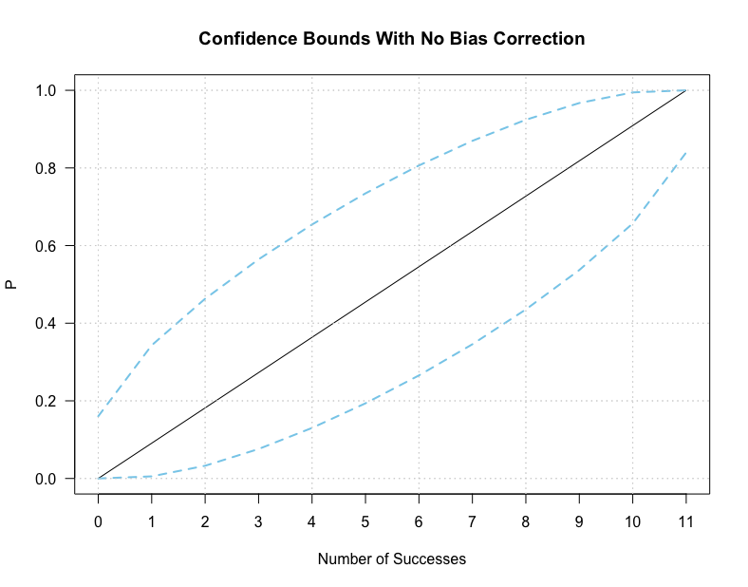
Profile Likelihood Confidence Intervals
Profile likelihood is often used when accurate interval estimates are difficult to obtain using standard methods.
In cases where the likelihood function is not symmetric about the MLE, the Profile Likelihood Based Confidence Interval serves better.
This is because it is based on the asymptotic chi-square distribution of the log likelihood ratio test statistic.
An Edwards AFB Practitioner's Guide 14

Slide 16
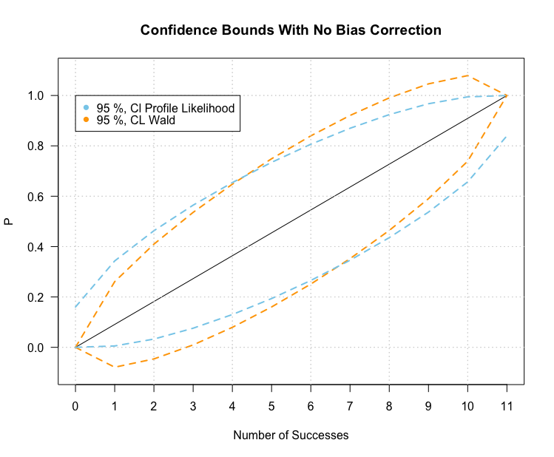
Wald vs. Profile Likelihood
This graph lets us see the two different types of intervals on top of each other.
As mentioned before, you can see how the Wald interval peaks above 1 and below 0 while Profile Likelihood does not.
Another observation is that Profile Likelihood bounds only every touch 0 and 1 at the very ends of the Number of Success axis, but only for either the lower or upper, not both. This leaves room for chance to occur.
An Edwards AFB Practitioner's Guide 15

Slide 17
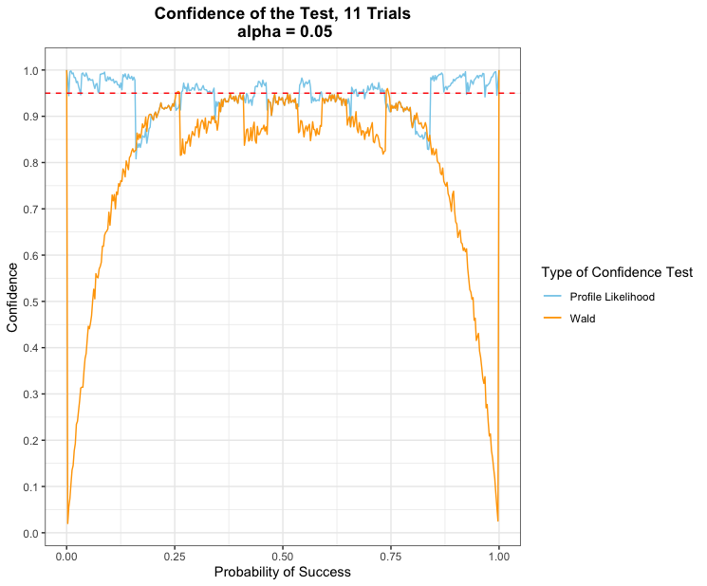
Confidence of the Tests
This plot illustrates the performance of the two confidence interval types. The closer the confidence interval is to the red dashed line, the more assured we are that our confidence intervals remain reliable for all probabilities.
The Wald Confidence as seen in the plot, does not remain near the line as the probabilities get closer to 0 and 1. This lets us know that if we want to be (1 - alpha)% confident, we would do best choosing the Profile Likelihood Test over Wald.
An Edwards AFB Practitioner's Guide 16

Slide 18
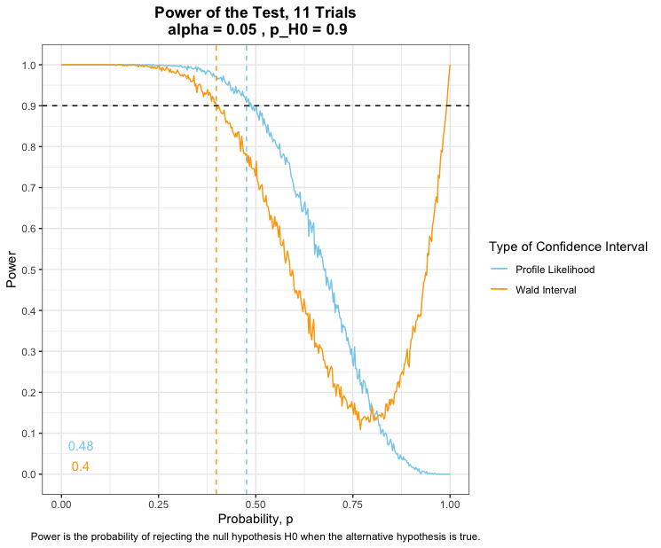
Power of the Tests
Power is the probability of rejecting the null hypothesis H0 when the alternative hypothesis is true. The power of a hypothesis test is between 0 and 1; if the power is close to 1, the hypothesis test is very good at detecting a false null hypothesis.
The graph shown in this section shows the power of each type of confidence interval for every hypothesized p (p_H0). What we are looking for is the type of interval that has the largest power.
From this visual, we can see that Power is greater with Profile Likelihood than with Wald Interval.

Slide 19
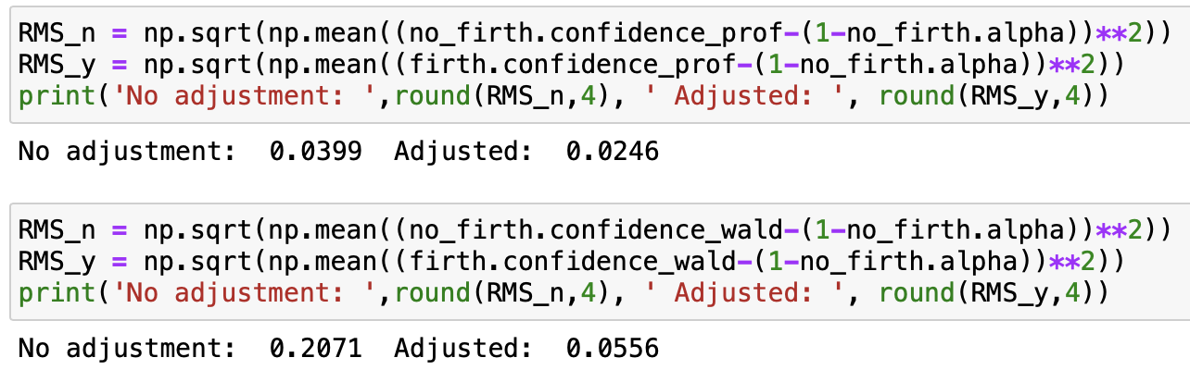
Future Work
A field of possible interest is in Firth’s Bias Correction.
What you do is add .5 the number of successes and 1 to the number of trials.
The first row of numbers belong to the RMSE of Profile Likelihood. It easy to notice that the change isn’t too drastic. The change from No Adjusted to Adjusted is 38 % decrease.
Row two belongs to Wald. With the Firth Correction applied, the RMSE went from 0.2701 to 0.0556, an 80% decrease from No adjustment. This could prove helpful in future experimentations.

Slide 20
References
https://towardsdatascience.com/five-confidence-intervals-for-proportions-that-you-should-know-about-7ff5484c024f
https://ncss-wpengine.netdna-ssl.com/wp-content/themes/ncss/pdf/Procedures/PASS/Tests_for_One_Proportion.pdf
https://journals.sagepub.com/doi/pdf/10.1177/1536867X0700700305
Engineering Statistics, 5th Edition:, Runger, Norma F. Hubele

Slide 21

Internship Report
10 May 2021 – 30 July 2021

Slide 22
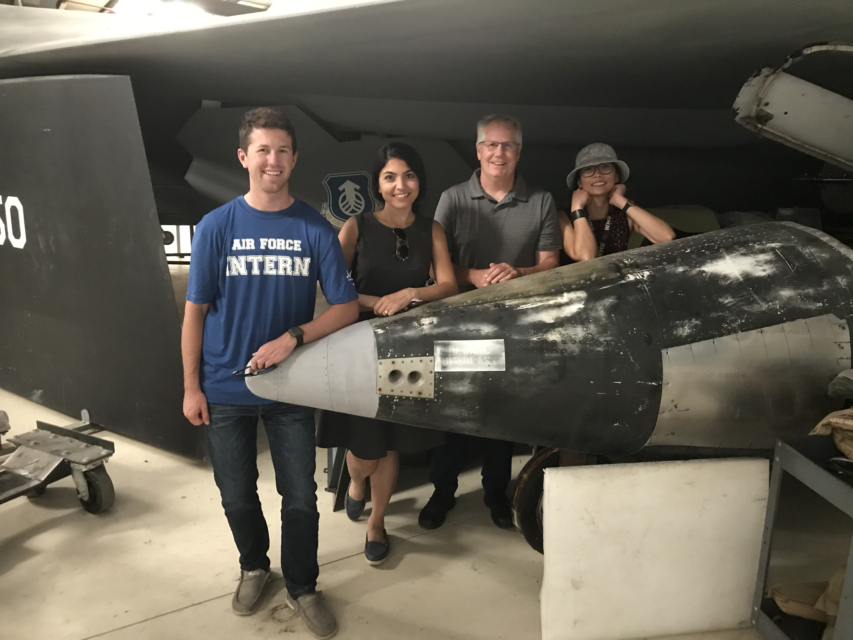
What Did I Learn
Effort = Level of Quality = Satisfaction
Each day, I got to choose what kind of day I wanted to have. Being lazy was easy, but not rewarding. Pushing myself to learn, ask, and be involved was more challenging, but that is what made me happy at the end of the day.
Understanding is much more important than Knowing
From all the classes and projects I got to participate in I found it much more important to explain what was happening, especially with Statistics.
Technical Skills
I was fortunate enough to give two presentations to the stats group, which was great! I was able to also working on my coding skills, especially when dealing with statistical analysis.

Slide 23
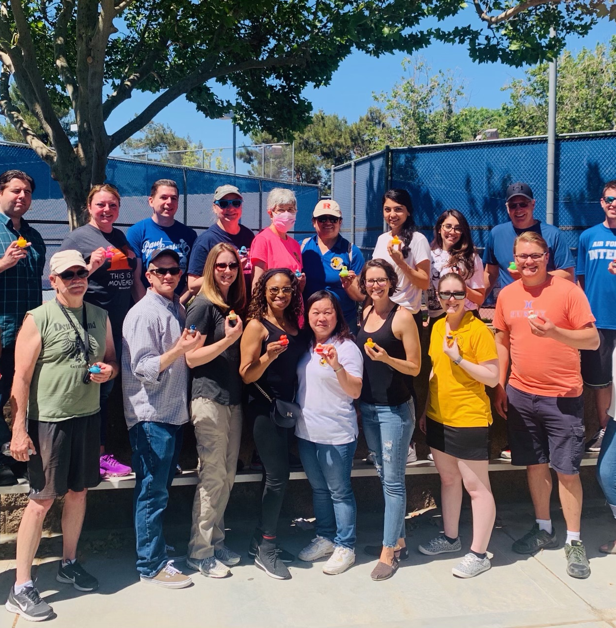
What Could Have been Better?
Be done with COVID, not have computer problems…
Emphasize the opportunities that come with a Mentor!
A mentor is more than someone that is to “look at your work”. They allow you to observe their workstyle, answer questions, explain opportunities, and be a good example.
Projects ( I would recommend at 3 projects to be done)
I really enjoyed all the projects I got to do.
Logit/ Probit
Coding
Leaving Presentation
Work with more people

Slide 24

What I hope to do now
LEARN MORE!
Complete Undergrad, get my Masters, MAKE A DIFFERENCE!
I want to go back to school and promote Data Science/ Statistics.
There are great opportunities.
Continue learning more about opportunities that come with my acquired knowledge and skills.

Slide 25

Thank you!
Basketball
German Bagels - They were GREAT!
Racquetball
Pickleball
Corn Whole
Olive Mediterranean Café
Museum
Unmuting so people can hear you laugh
My own cubical space
Lots of merchandise
And many more Great Experiences!

